Slide 1

Metrics, models and foresight for sustainable food and nutrition security in Europe
Thom Achterbosch, 2nd Plenary Project Meeting, Brussels, 26-28 Oct. 2016
H2020
Grant no.
633692
Notes:
Grant no. 633692 (Horizon 2020)
<Foliennummer>

Slide 2
Interdisciplinary research on metrics, models and foresight for sustainable food and nutrition security in Europe
Working with partners towards EU food systems for health, environment and enterprise...
...By delivering high-quality research on metrics, models and foresight to support evidence-based policies and innovation strategies for a sustainable and food and nutrition secure EU.
H2020
Grant no.
633692
Notes:
Working towards “EU food systems for health, environment and enterprise“...
SUSFANS wants to make a leading scientific contribution to a balanced and encompassing view on improving food and nutrition security outcomes and making food in the European Union more sustainable. In short: to achieve sustainable food and nutrition security (FNS) in the EU. Our research is led by the notion that improvements in the diets of the European consumer must come from, and be supportive of, food systems that contribute to public health, environmental protection and thriving enterprise in the long term.
...By delivering high-quality research to support evidence-based policies and innovation strategies for a sustainable and food and nutrition secure EU.
SUSFANS will deliver high-quality research on metrics, modelling and foresight to improve the navigation on sustainable food in the public and private arena. The group of sixteen organisations in SUSFANS responsible for delivering and disseminating research will cross barriers between social sciences and agricultural disciplines, and will engage intensively with stakeholders in the European food system. In doing so, SUSFANS builds bridges between the worlds of agriculture and food on one hand, and public health and nutrition on the other.
<Foliennummer>

Slide 3




EU Sustainable food & nutrition security
– food system public goods and “bads”
Burden of disease;
calorie deficiency (in NMS)
10% ↘ fruits & vegetables, ↗salts
8% underweight (children)
(Lim, 2010)
5-7% of people
in NMS undernourished
(IFPRI, 2014; Cockx et al. 2015)
20-75% of cancers
is attributable to diet
(WCRF, 1997)
people
Growth & jobs
In EU MS farms, fishing & food/bev industries contribute
5-15% of GDP;
1-30% of jobs
(Eurostat 2015)
profit
planet
CC, resource eff., biofuel, food losses
15-28% of total
GHGe is attributable to food consumption
(Garnett, 2011)
Notes:
Update with CF
European diets need to become more environmentally and economically sustainable, and more healthy and nutritious, as evident from recent policy documents on the CAP (COM (2010) 672), nutrition, overweight and obesity-related health (COM (2007) 279), resource efficiency (COM 2011) 571) and the circular economy (COM (2014) 398).
Climate change is one of the five EU-wide headline targets, which need to be translated into national targets. Compared to
1990 the targets for 2020 are: 20% less greenhouse gas emissions, 20% more renewable energy and 20% increase in energy efficiency(2)
Farm labour (25 mln persons. or 10 mln full time jobs i.e. 5% of total EU employment. 75% self-employed mainly holders)
Fisheries labour? See national accounts
Food and beverage industry? See national accounts
share of total employment
Primary : Between 1% and 31% of total employment in 2011 national accounts
Sources
http://ec.europa.eu/agriculture/rural-area-economics/briefs/pdf/08_en.pdf
<Foliennummer>

Slide 4
EU Sustainable food & nutrition security
– a policy view on food system
Nutrition, overweight and obesity-related health
(COM (2007) 279)
EU Action Plan on Childhood Obesity 2014-2020
Action Plan on (global) Nutrition
Roadmap to limit
industrial trans fats intakes
people
Food losses and waste
Climate change
Resource efficiency
(COM (2011) 571)
Common Agricultural Policy
(COM (2010) 672)
planet
profit
Ratification of Paris Agreement UNFCCC
2020 CAP reform
Circular economy
(COM (2014) 398)
Arguing for European diets to become more environmentally and economically sustainable, and more healthy and nutritious
Notes:
UPDATE with conceptual framework
Food losses and waste
European diets need to become more environmentally and economically sustainable, and more healthy and nutritious, as evident from recent policy documents on the CAP (COM (2010) 672), nutrition, overweight and obesity-related health (COM (2007) 279), resource efficiency (COM 2011) 571) and the circular economy (COM (2014) 398).
Climate change is one of the five EU-wide headline targets, which need to be translated into national targets. Compared to
1990 the targets for 2020 are: 20% less greenhouse gas emissions, 20% more renewable energy and 20% increase in energy efficiency(2)
Farm labour (25 mln persons. or 10 mln full time jobs i.e. 5% of total EU employment. 75% self-employed mainly holders)
Fisheries labour? See national accounts
Food and beverage industry? See national accounts
share of total employment
Primary : Between 1% and 31% of total employment in 2011 national accounts
Sources
http://ec.europa.eu/agriculture/rural-area-economics/briefs/pdf/08_en.pdf
<Foliennummer>

Slide 5
Sustainable food and nutrition security
Food and nutrition security
World Food Summit, 1996
+
Sustainable food system
Contributing to health
Environmentally sound
Viable enterprise, decent living
Global food and nutrition security
Notes:
Healthy diet from a sustainable & robust food system
Food security : When all people, at all times, have physical, economic and social access to sufficient, safe, and nutritious food to meet their dietary needs and food preferences for an active and healthy life.
<Foliennummer>

Slide 6
SUSFANS research objective
«To build the conceptual framework, the evidence base and analytical tools
for underpinning EU-wide food policies with respect to their impact on consumer diets and their implications
for nutrition and public health in the EU, the environment, the competitiveness of the EU agri-food sectors, and global food and nutrition security»
Notes:
<Foliennummer>

Slide 7
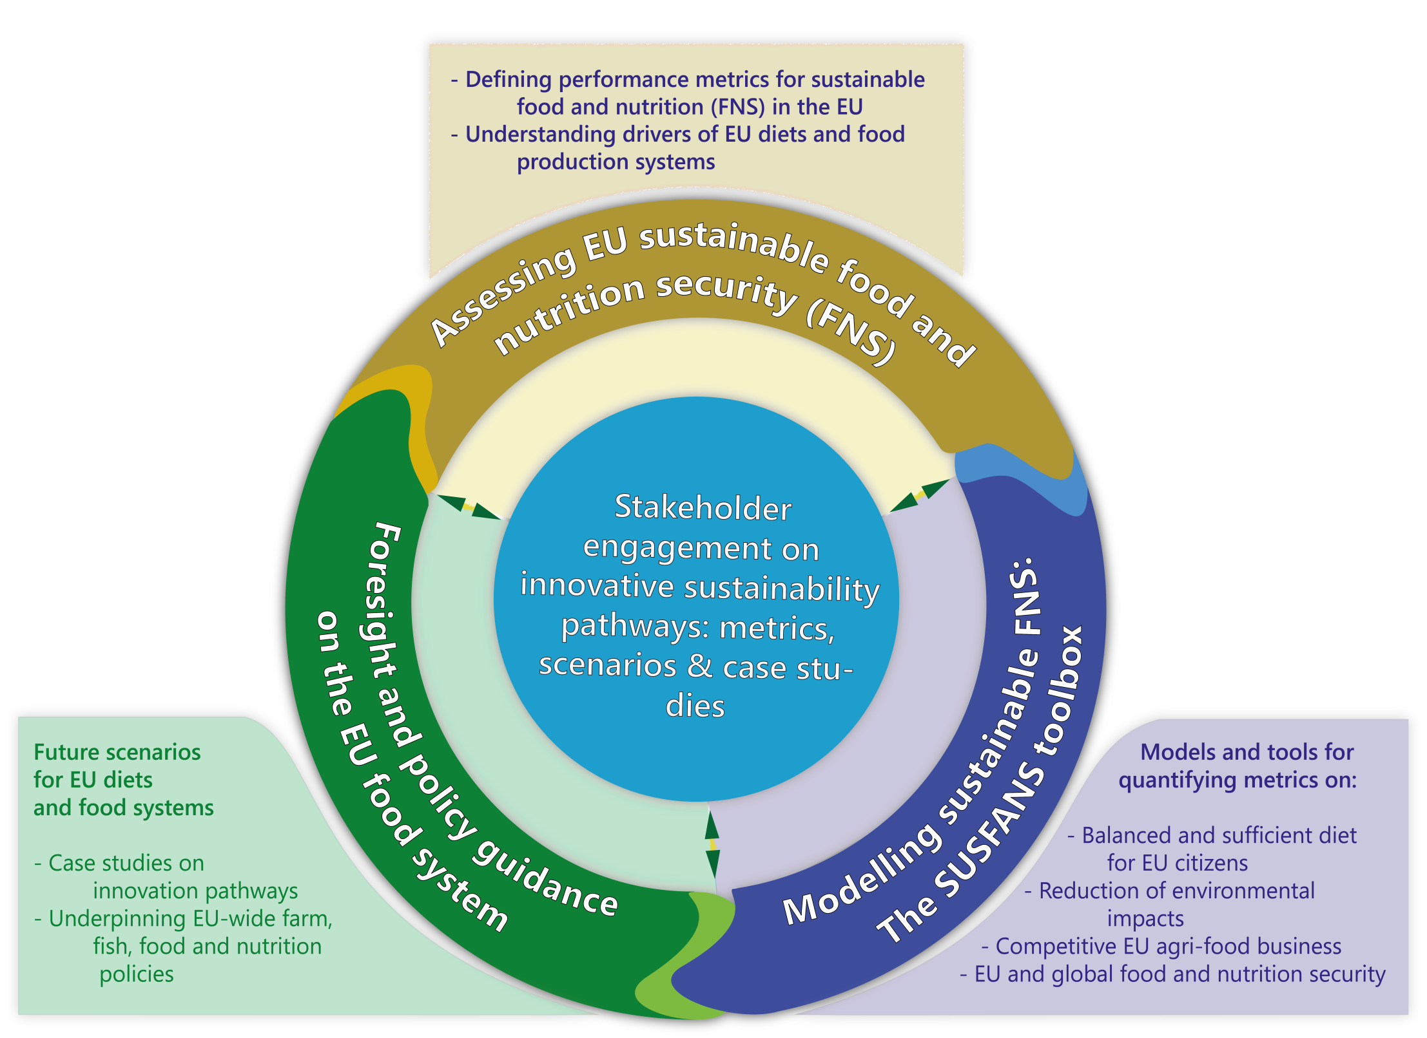
Research
strategy
1
3
2
Notes:
1
<Foliennummer>

Slide 8
Leverage points for sustainable nutrition (working hypotheses)
Strengthening EU food and nutrition security requires more sustainable food consumption and production
Consumer diets a pivotal tool – a shared responsibility!
Impact of consumer choice & diets on society ←→decisions along entire food value chain
Innovation and policy reform drive societal change
Need analytical tools to inform debate
Notes:
1.
2. Note the memo from HHS and USDA:
The diet is an important tool to improve public health
4. Tools: metrics for sustainable food system. Metrics for a healthy and sustainable diet
<Foliennummer>

Slide 9















SUSFANS Research Consortium
(2015-2019)
Grant no. 633692 under H2020-SFS-19A (Societal challenge 2)
Notes:
1.
2. Note the memo from HHS and USDA:
The diet is an important tool to improve public health
4. Tools: metrics for sustainable food system. Metrics for a healthy and sustainable diet
<Foliennummer>

Slide 10
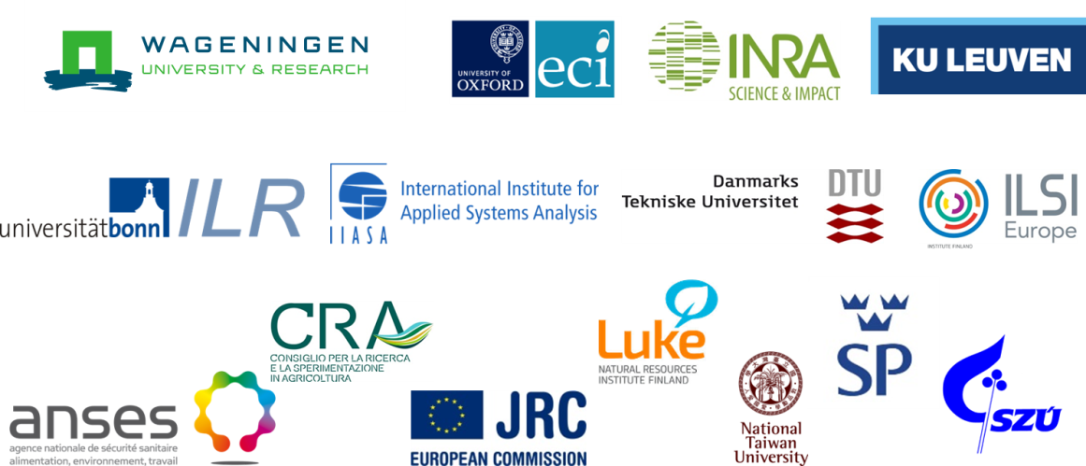




SUSFANS & SHARP partnership
SUSFANS
SHARP-BASIC
Notes:
SUSFANS
SHARP-BASIC
<Foliennummer>

Slide 11
Organization of research activities
ASSESSING
SUSTAINABLE FNS
MODELLING
SUSTAINABLE FNS
POLICY GUIDANCE
WP1 Conceptual Framework and FNS sustainability metrics
WP8 Short term forecasts and early warning
WP9 Long term modelling of sustainable FNS
WP 10 Foresight
WP2 Drivers and data: food consumption and diets
WP3 Drivers and data: food chain actors
WP 11 Impact and dissemination
WP7 Modelling SHARP diets for EU consumers
WP4 Drivers and data: primary agricultural and fisheries production
WP5 Case studies
WP6 Stakeholder interaction and scenario development
Notes:
J. Ingram 2015
Sustainable diets = Those diets with low environmental impacts which contribute to food and nutrition security and to a healthy life for present and future generations. Sustainable diets are protective and respectful of biodiversity and ecosystems, culturally acceptable, accessible, economically fair and affordable; nutritionally adequate, safe and healthy while optimizing natural human resources.
Consumer buy-in for sustainable diets = palatable products, tasty recipes in line with complex preferences and consumption habits.
Producer buy-in for sustainable diets = profitability, differentiated but scalable production and marketing strategies, resource availability in the long run
<Foliennummer>

Slide 12
2nd plenary project meeting

Slide 13
Objective
Review scientific progress in the first 18 months
Foster collaboration across teams and tasks
Getting ready to deliver final metrics in March ’17
Preparing 2nd stakeholder meeting
Day 1
  Metrics for assessing sustainable FNS
  Papers on drivers and data
  Justify case studies
Day 1½
  Modelling toolbox: how to quantify metrics and scenarios?

Slide 14
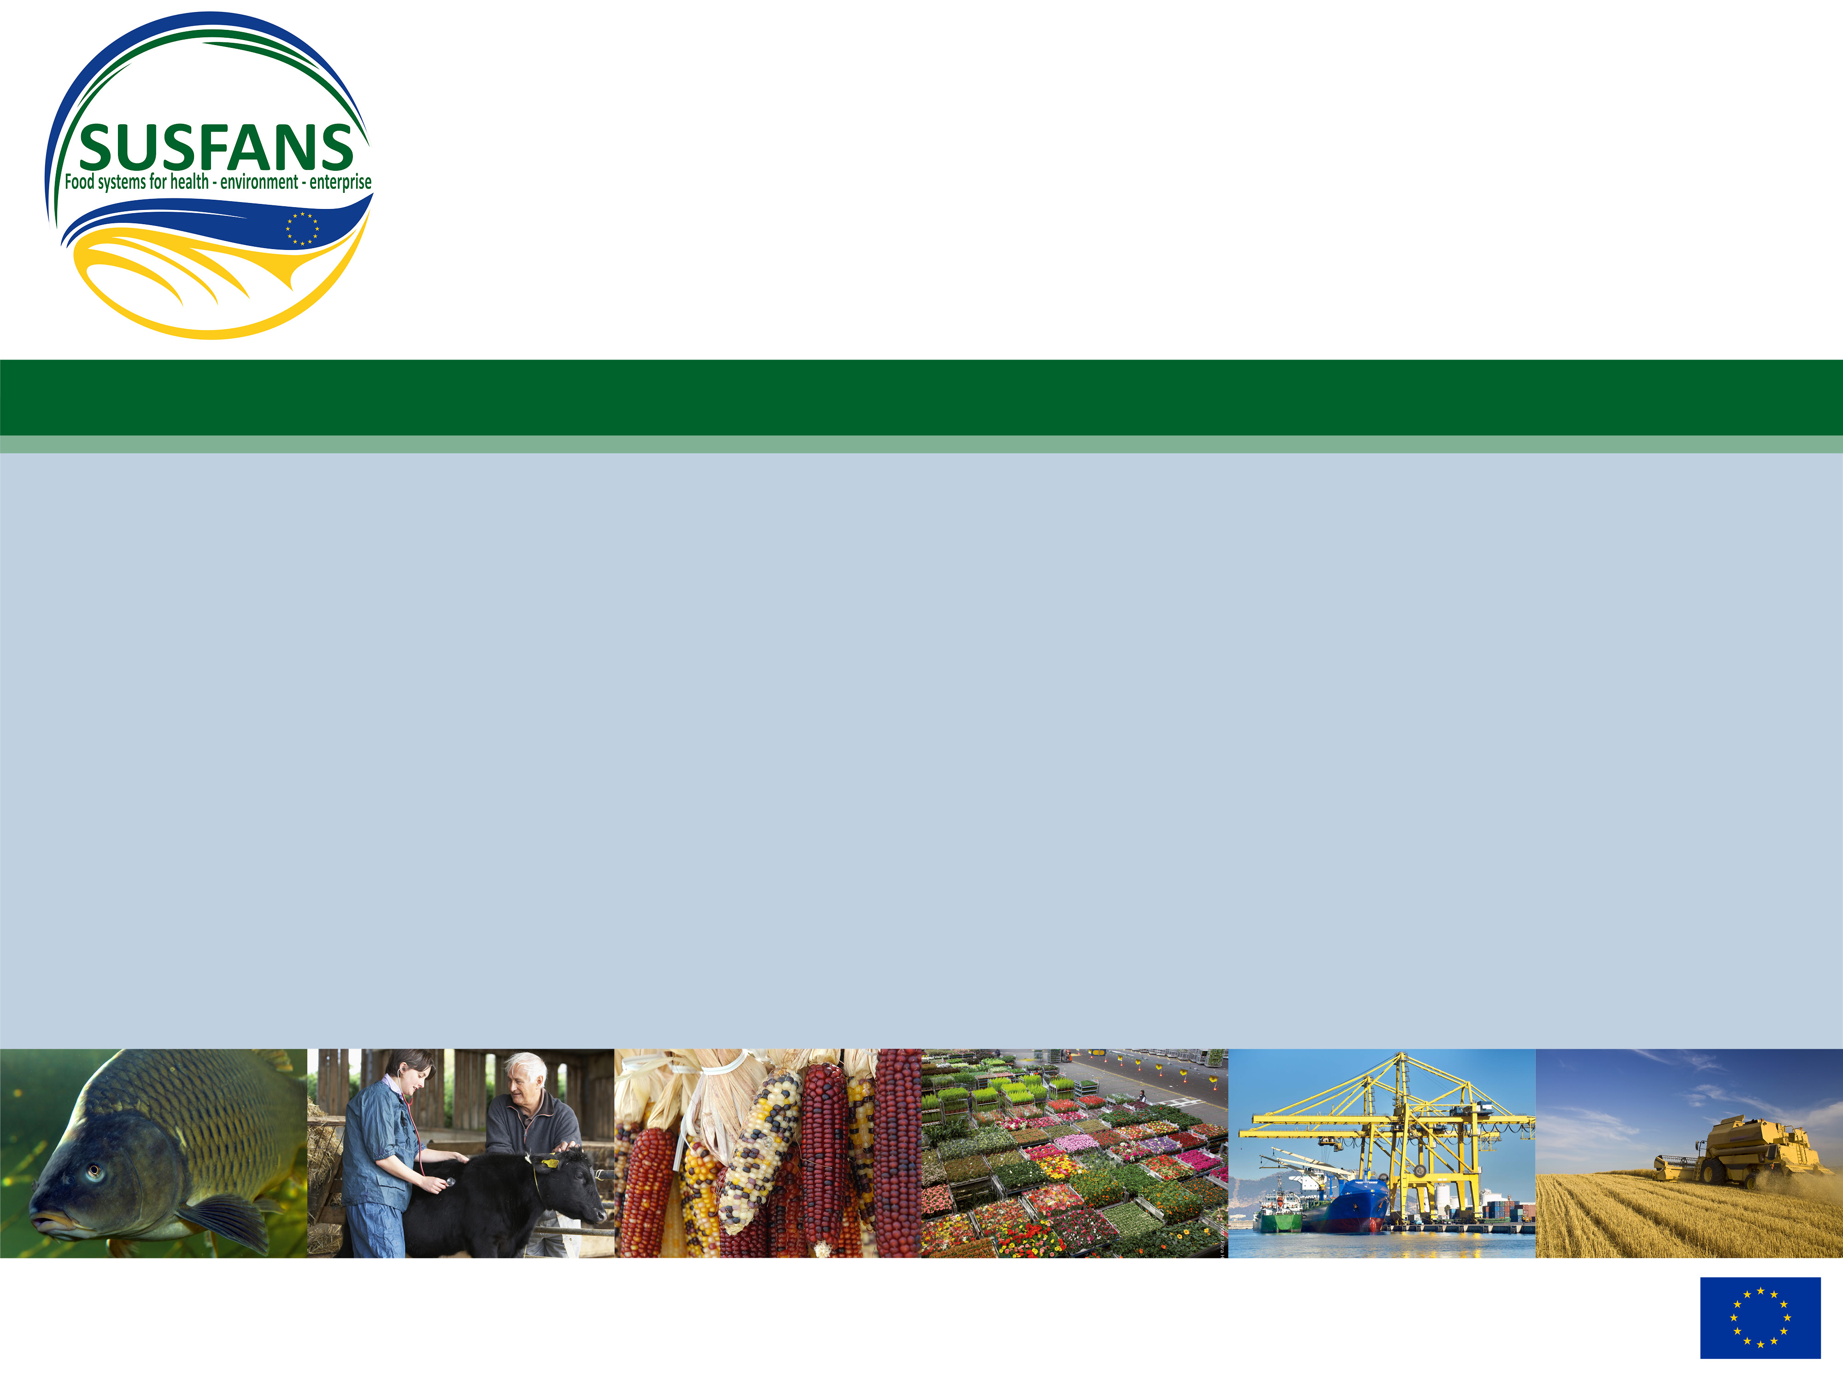
Thank you!www.susfans.eu
thom.achterbosch@wur.nl

